Slide 1

Selenium WebDriver - Tutorial

Slide 2
Contents
Complete Core Java
Selenium WebDriver – Focus
Selenium Grid
Live Project on Selenium
Interview Questions
TestNG
Maven
ANT
Jenkins
Log4j
Test Execution reports
Cucumber
Data Driven Framework
Hybrid Framework
Page Object Model Framework
Database Testing with Selenium
Performance Testing
Mobile Automation
Cloud Automation

Slide 3

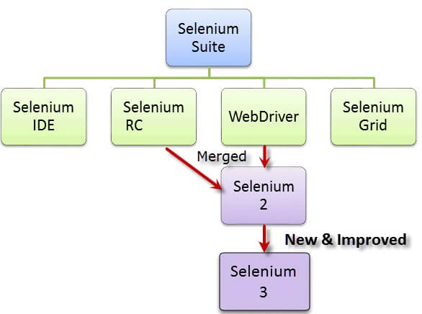
Selenium History
Selenium is a free (open source) automated testing suite for web applications across different browsers and platforms.
It is quite similar to HP Quick Test Pro (QTP now UFT) only that Selenium focuses on automating web-based applications.
Testing done using Selenium tool is usually referred as Selenium Testing.
Selenium is not just a single tool but a suite of software's, each catering to different testing needs of an organization. It has four components.

Slide 4
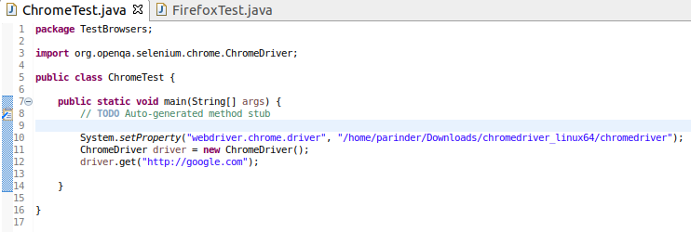
Choose Browser - Interface WebDriver
Interface WebDriver
All Known Implementing Classes:
ChromeDriver, EdgeDriver, EventFiringWebDriver, FirefoxDriver, InternetExplorerDriver, OperaDriver, RemoteWebDriver, SafariDriver
How to run tests in Google Chrome ?
Invoke .exe file before creating object Code: system.setproperty("keys","value") System.SetProperty("webdriver.chrome.driver", "path of exe file")
Create driver object. Syntax (Java) : class name = x x obj_name = new x(); ChromeDriver driver= new ChromeDriver(); For chrome choose ChromeDriver – interface webdriver.
Import package.
Get link for test. code: driver.get("http://google.com");

Slide 5
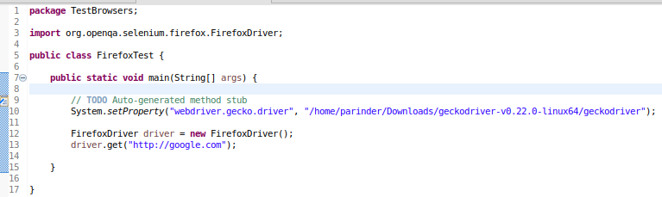
Choose Browser - Interface WebDriver
How to run tests in Mozilla Firefox ?
Invoke .exe file before creating object Code: system.setproperty("keys","value") System.SetProperty("webdriver.gecko.driver", "path of exe file")
Create driver object. Syntax (Java) : class name = x x obj_name = new x(); FirefoxDriver driver= new FirefoxDriver(); For Mozilla choose FirefoxDriver– interface webdriver.
Import package.
Get link for test. code: driver.get("http://google.com");

Slide 6
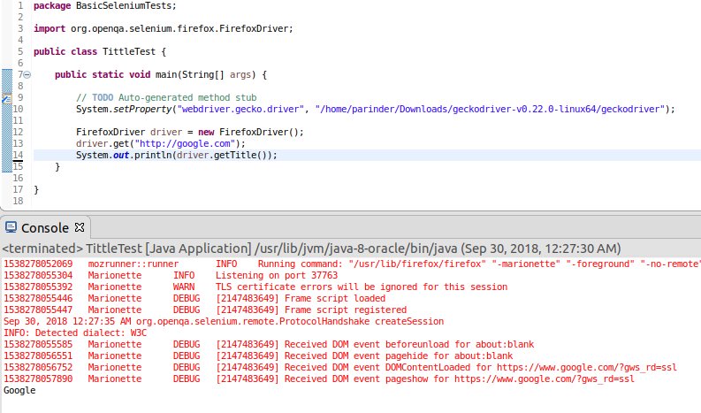
Basic Selenium Methods- Title

Slide 7
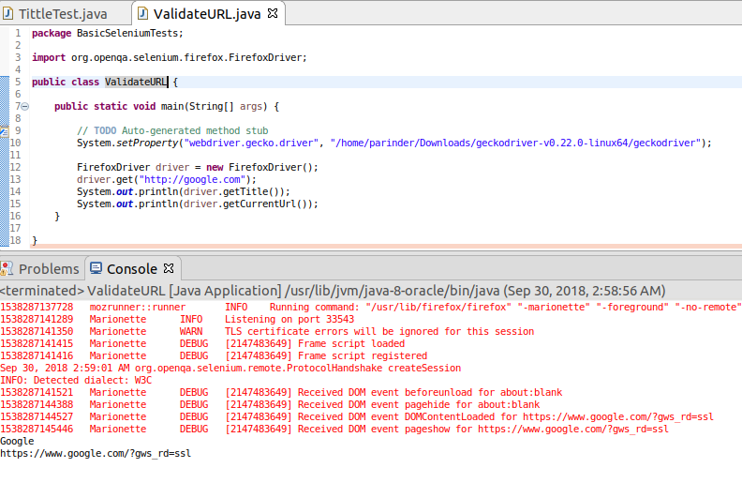
Basic Selenium Methods– Validate Exact URL
If someone hacked the current url, how can validate the link landed on exact url or not ?
driver.getcurrentUrl();

Slide 8
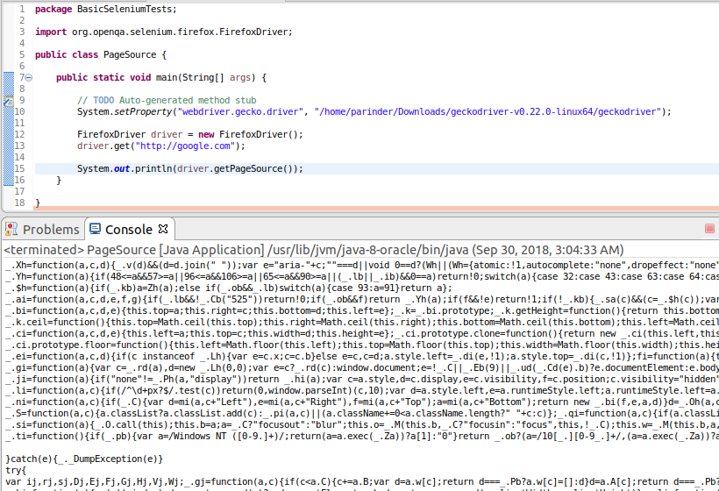
Basic Selenium Methods– Page Source
If any website(Banking Sites) right click disabled, not able to see page source.
Driver.getpagesource();

Slide 9
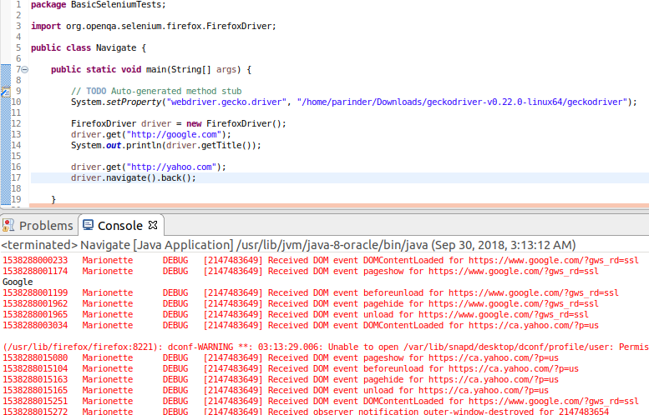
Basic Selenium Methods– Back To URL
If you hit another link from your current webpage/link, How can you going back to orignal url ?
driver.navigate().back();
driver.navigate().forward();
get() vs navigate(): get method wait for loading all the contents of the webpage. Where as navigate not wait for lpading all contents.

Slide 10
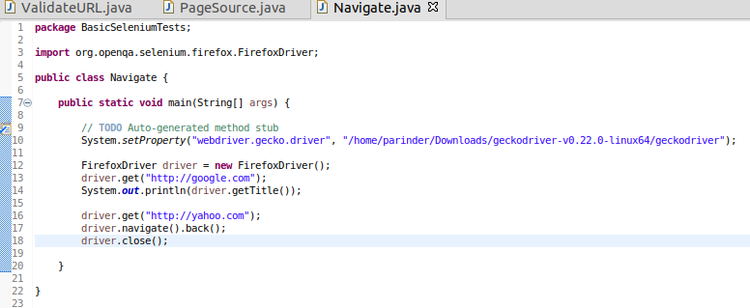
Basic Selenium Methods– Close & Quit Browser
close() vs quit (): Close method close the particular bowser which related to test where as quit method close all the open browsers.
After execution of test on browser, close the browser.
driver.close();
driver.quit();

Slide 11
Locator Techniques & Tools – Identify Objects
Locator: Locator is a command that tells Selenium which GUI elements ( say Text Box, Buttons, Check Boxes etc) its needs to operate on.
Locator Supported by Selenium WebDriver:
ID
CSS
Classname
Name
LinkText
xpath

Slide 12
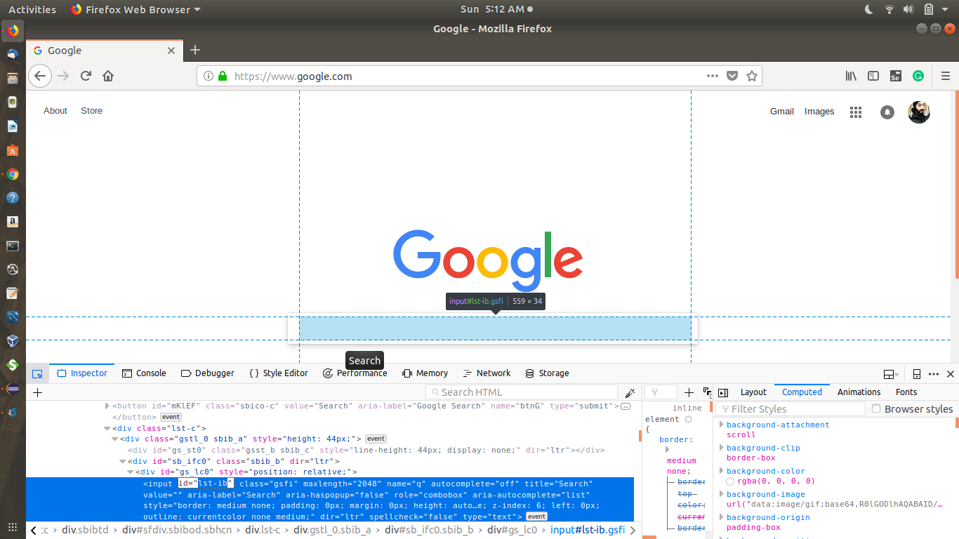
Locator Techniques & Tools – Id
Test the text-field by loctors: Steps:
Inspect the webpage first – google.com
Click on Text field and right click > select inspect Element
Identify the attribute which deal with that text field.
Apply on the code.

Slide 13
Locator Techniques & Tools – Id
Test the text-field by loctors: Steps:
Inspect the webpage first – google.com
Click on Text field and right click > select inspect Element
Identify the attribute which deal with that text field.
Apply on the code.

Slide 14
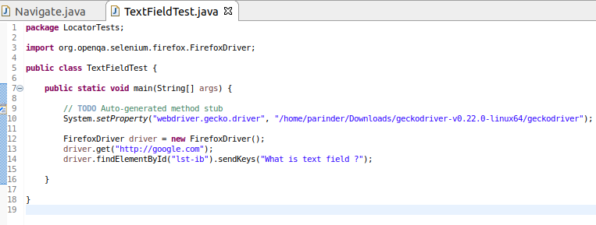
Locator Techniques & Tools – Id Locator
Use method to search and enter text in text field: driver.findElementById("lst-ib").sendKeys("What is text field ?");

Slide 15
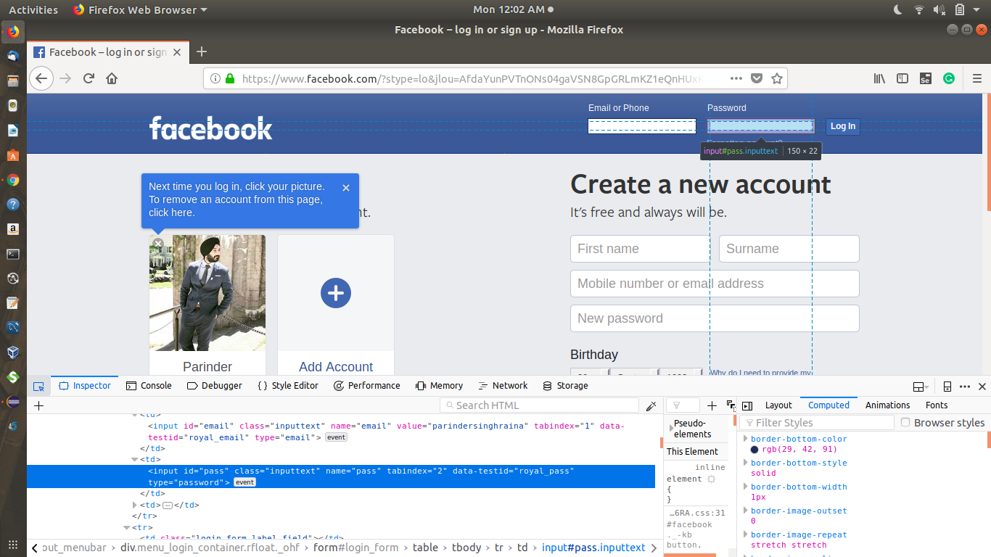
Locator Techniques & Tools – Name Locator
Inspect the "name" locator and apply the value in the script.

Slide 16
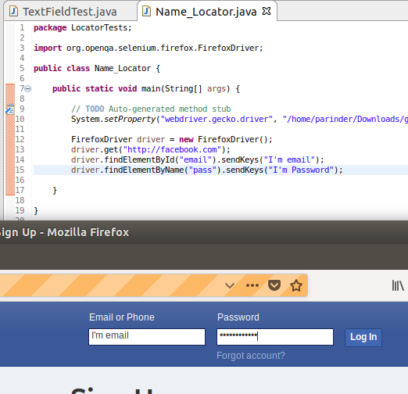
Locator Techniques & Tools – Name Locator
Use method to search the element by name locator. driver.findElementByName("value").sendKeys("string")

Slide 17
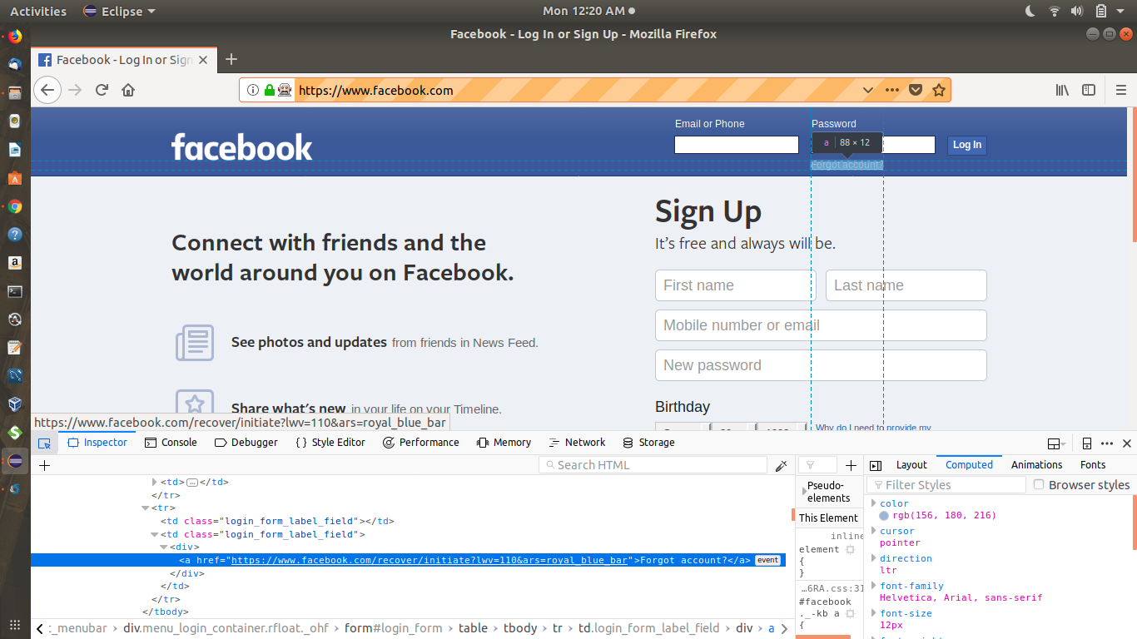
Locator Techniques & Tools – linkTextLocator
Inspect the "Forgot Account" in the inspector we can see a link only there is an anchor tag <a no id, name or classname. In this case we use linkText to capture or test that element.

Slide 18
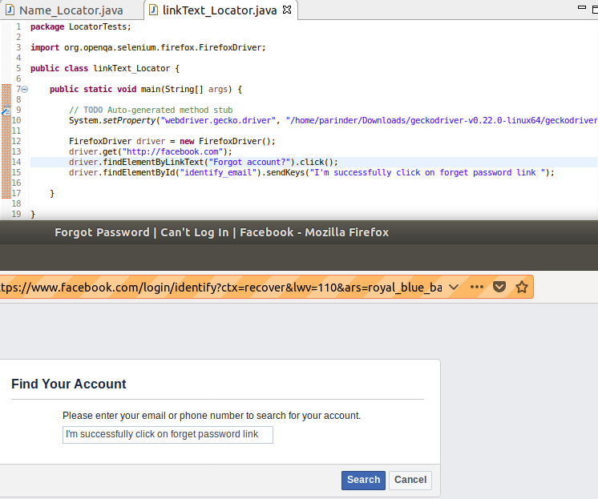
Locator Techniques & Tools – linkTextLocator
LinkText is used for searching or identifying any element without Id, name, classname. driver.findElementByLinkText("link value").click();

Slide 19
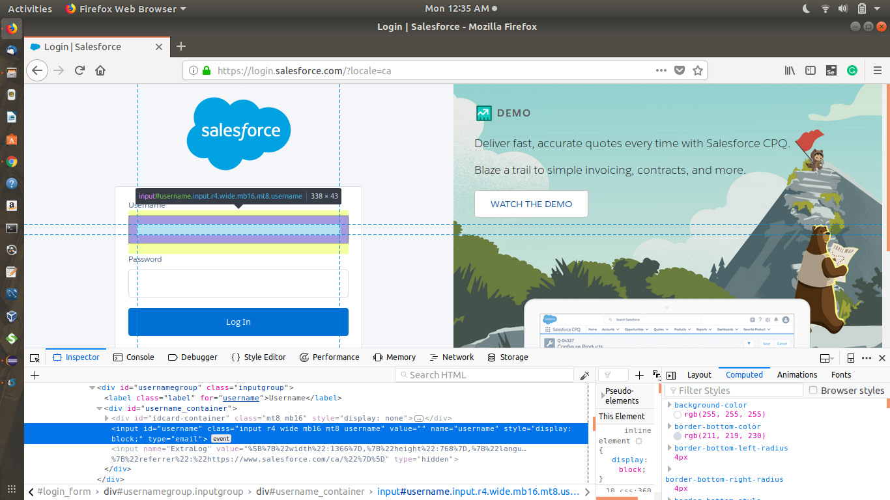
Locator Techniques & Tools – TIPs (Compound Class Error)
Classes should have spaces , it(compound class names) will not be accepted. *code error in next slide.

Slide 20
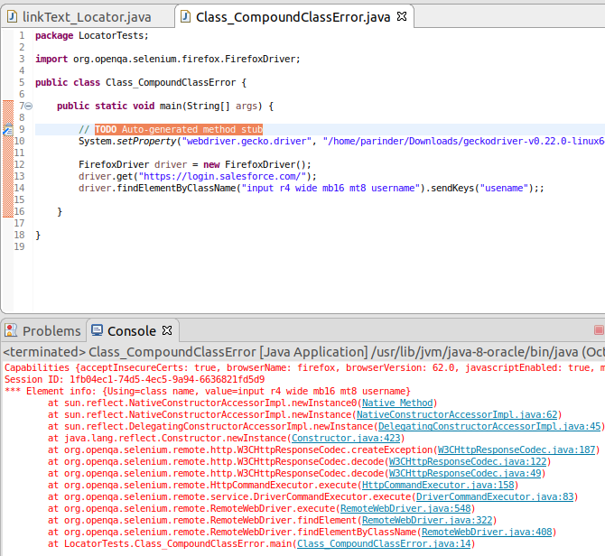
Locator Techniques & Tools – TIPs
Compound Class names not permitted.

Slide 21
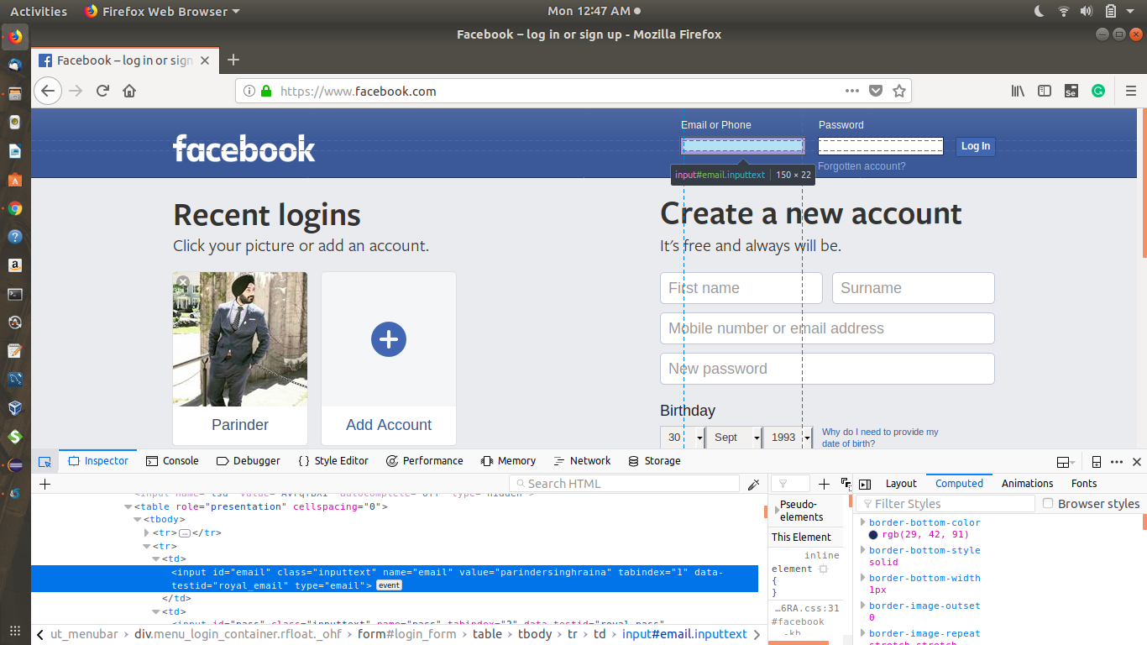
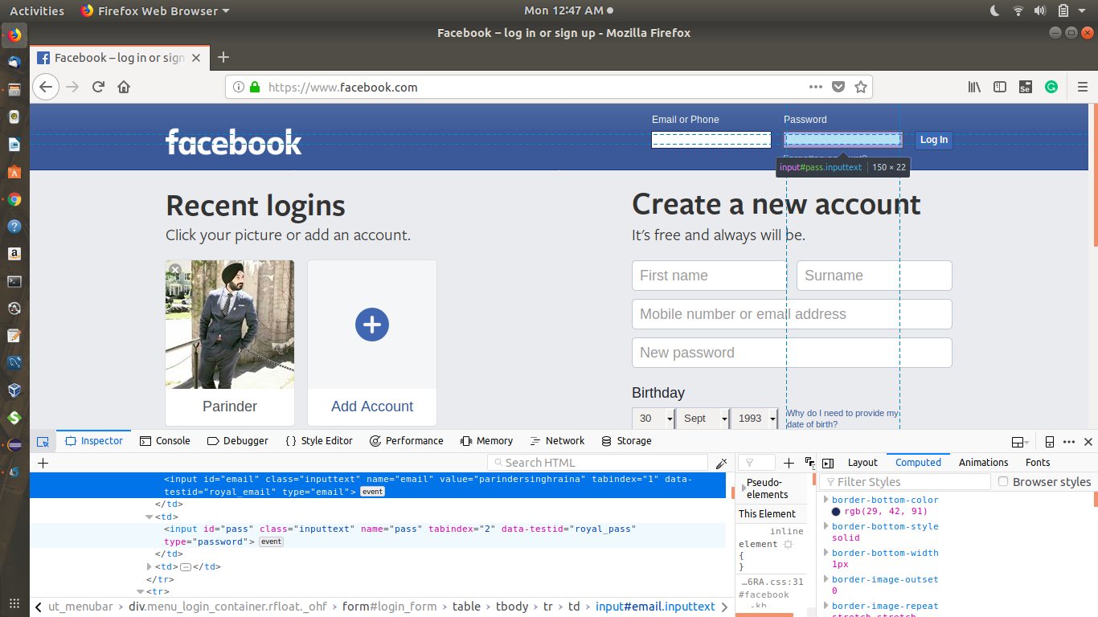
Locator Techniques & Tools – TIPs(Multiple values )
If any two element's attribute has same value, then selenium choose or scan the first one.
In the screenshots, email & password fields both have one common attribute "class=inputtext"

Slide 22
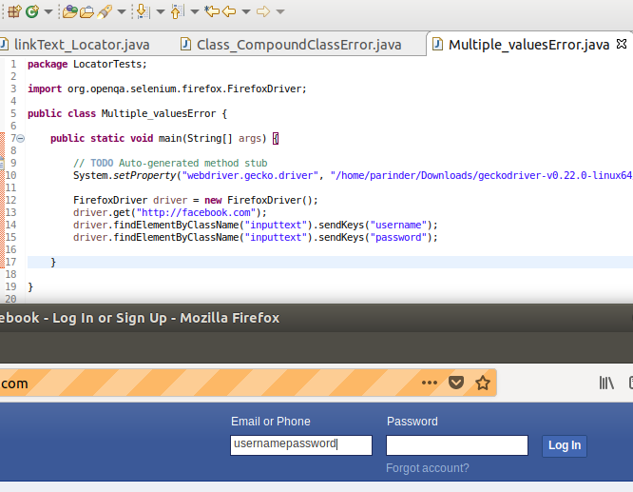
Locator Techniques & Tools – TIPs (Multiple Values)
Selenium choose the email text field, because it's comes first.

Slide 23
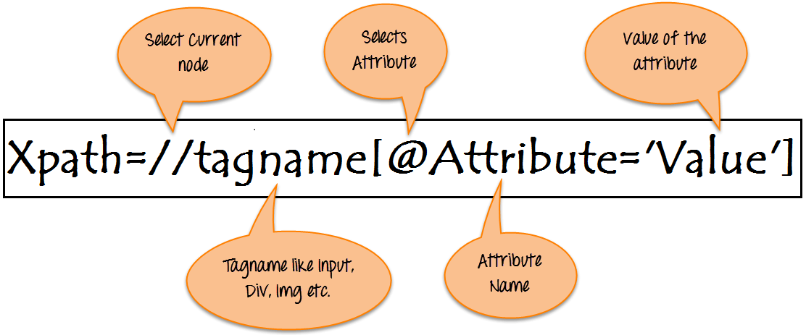
Locator Techniques & Tools – Xpath
In Selenium automation, if the elements are not found by the general locators like id, class, name, etc. then XPath is used to find an element on the web page .
XPath is defined as XML path. It is a syntax or language for finding any element on the web page using XML path expression.
Syntax for XPath:
XPath contains the path of the element situated at the web page. Standard syntax for creating XPath is.
Xpath=//tagname[@attribute='value']
// : Select current node.
Tagname: Tagname of the particular node.
@: Select attribute.
Attribute: Attribute name of the node.
Value: Value of the attribute.

Slide 24
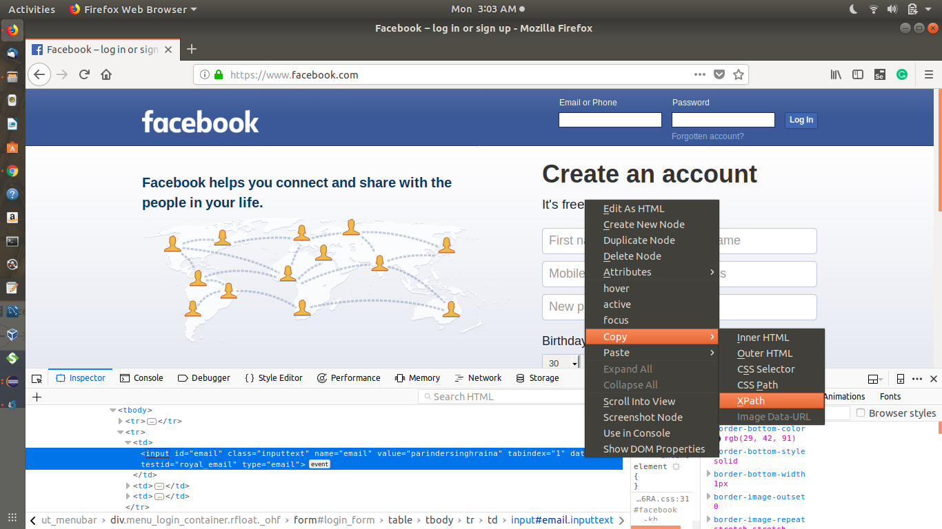
Locator Techniques & Tools – Xpath
How to define the xpath ?
Select the element and impact element.
Go to inspector window and right click on the highlighted link.
Select copy > xpath
Paste that link into word, notepad or Editor.
Verify the xpath. //*[@id="email"]
The copied xpath – attribute value is always in double quotes " "- that is not accpted by the code, the value always in single quote.

Slide 25
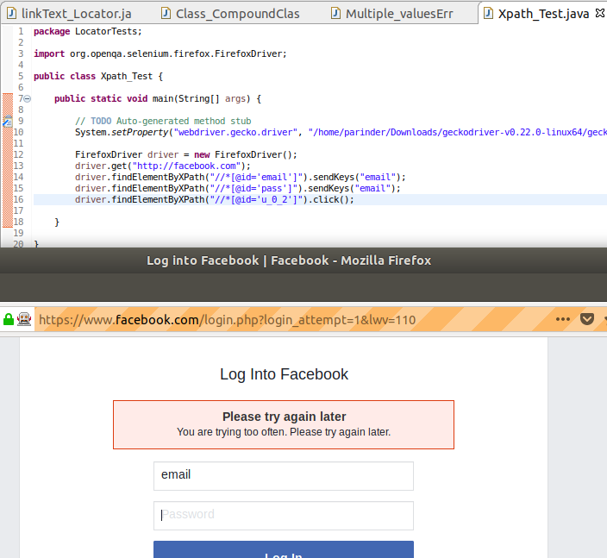
Locator Techniques & Tools – Xpath

Slide 26
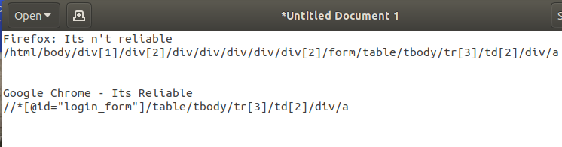
Locator Techniques & Tools – TIPs (Xpath)
When Xpath start with html - It's not reliable.
Solution: Switch the Browser and get the reliable path.

Slide 27
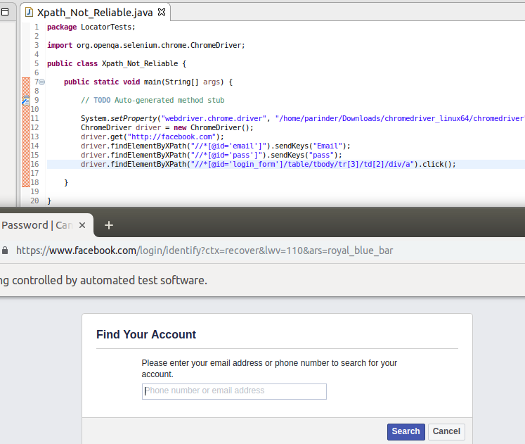
Locator Techniques & Tools – TIPs (Xpath)
In the firefox, there is xpath for the element "Forgot account" is start with html and it's not reliable. But in Google Chrome the xpath is reliable.

Slide 28
Locator Techniques & Tools – CSS Selector
A CSS Selector is a combination of an element selector and a value which identifies the web element within a web page. They are string representations of HTML tags, attributes, Id and Class. As such they are patterns that match against elements in a tree and are one of several technologies that can be uses to select nodes in an XML document.
Keep in mind that the locator is always preceded by a hash sign (#).

Slide 29
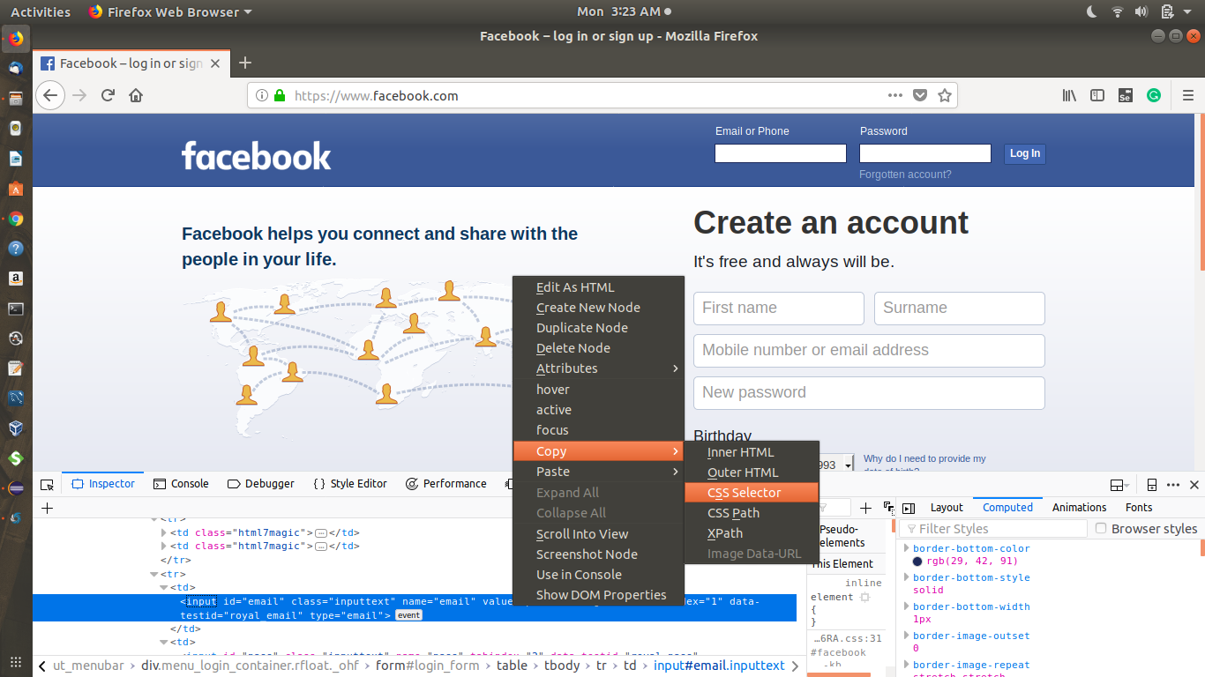
Locator Techniques & Tools – CSS Selector
How to define the CSS Selector ?
Select the element and impact element.
Go to inspector window and right click on the highlighted link.
Select copy > CSS Selector *Don't select CSS path
Paste that link into word, notepad or Editor.
Verify the CSS Selector.

Slide 30
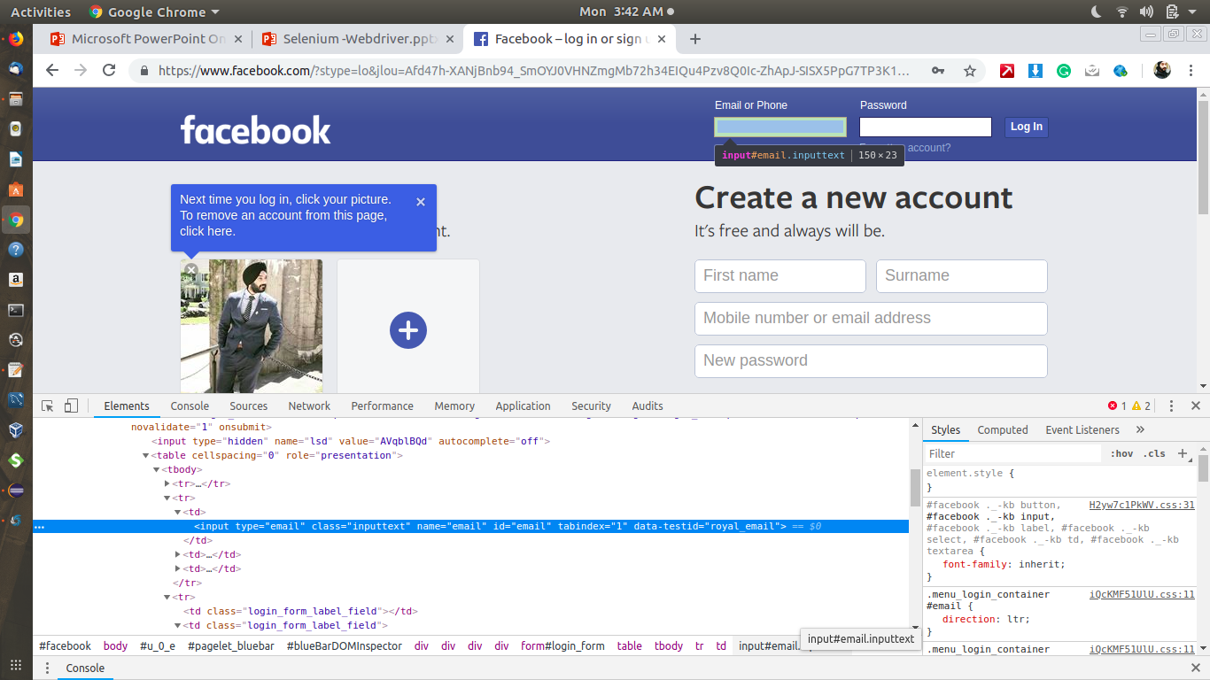
Locator Techniques & Tools – CSS Selector
How to get the CSS Selector in chrome?
Select the element and impact element.
Go to inspector window and right click on the highlighted link. But there is no option for CSS selector.
The CSS path always at the end of the chrome inspector window.
Drag all the values and analysis which one is suitable for that selected element.

Slide 31
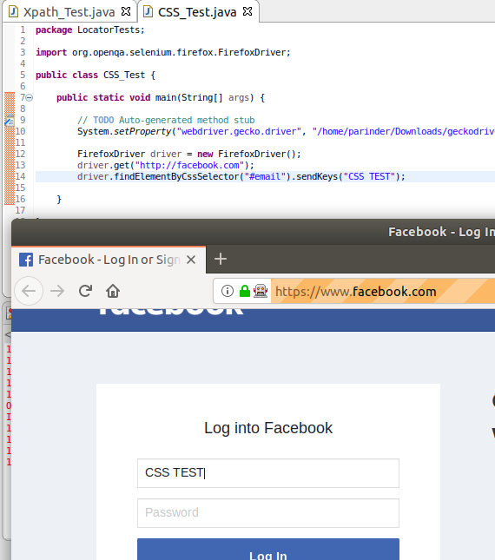
Locator Techniques & Tools – CSS Selector
CSS find by the method:
driver.findElementByCssSelector("value"). Send/click();

Slide 32
Validate the accuracy of Xpath & Css
How to validate the xpath & Css before writing to Code/Script ?
STEPS:
Inspect the element and copy the xpath/css from highlighted link.
Now verify the Xpath – remove the double quotes & no Html over there.
Go to browser > Inspector window > Console (type allow first)
At the end of console type: $x(" xpath ") / $( " Css ") - press enter.
If you get the highlighted link then xpath validate it's correct.
If null, that element is not present in page or xpath wrong.

Slide 33
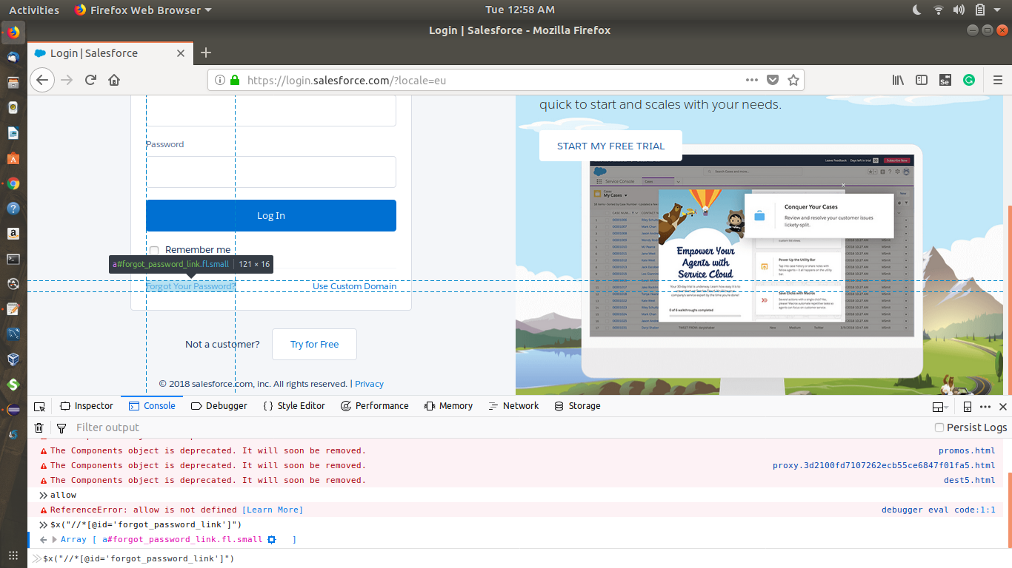
Validate the accuracy of Xpath & Css

Slide 34
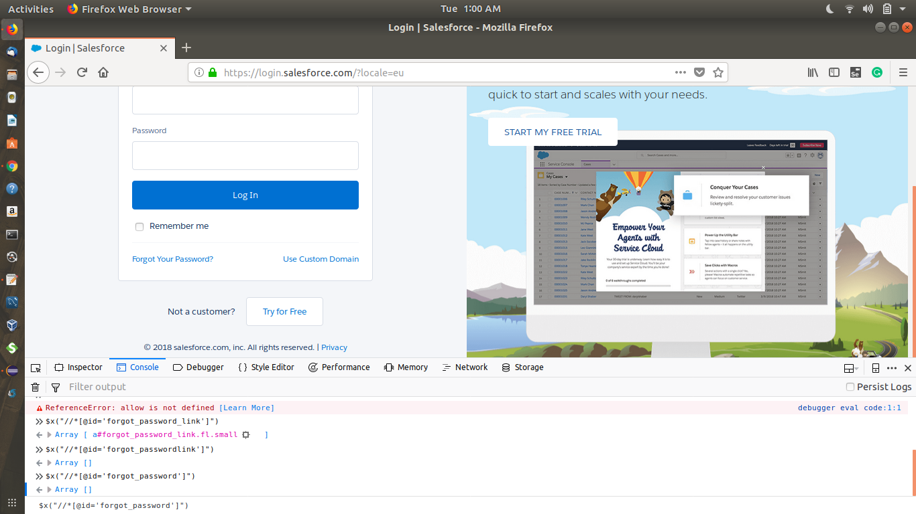
Validate the accuracy of Xpath & Css – Invalid xpath

Slide 35
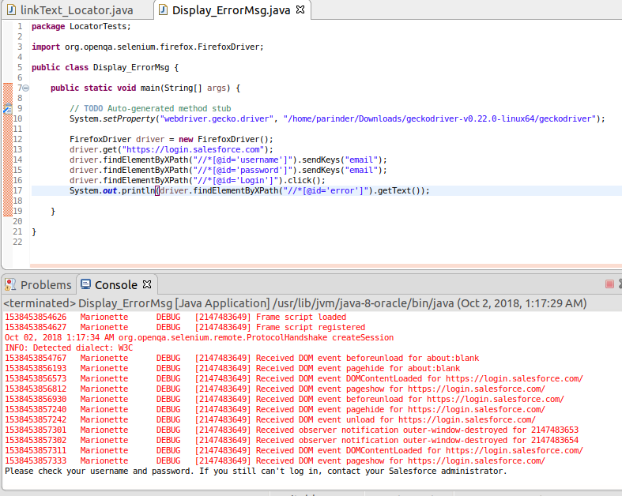
Display the Error Message in Console
Inspect the message through inspector and copy the xpath.
driver.findElementByXpath("xpath").getText();

Slide 36
Generating Customized Xpath From HTML Attributes
Steps:
First inspect the element & analysis the highligted link.
<input class="inputtext" name="email" id="email" value="parindersinghraina" tabindex="1" data-testid="royal_email" type="email">
In the above HTML code,
Input = Tagname
name = Attribute
email = Value
Xpath = //Tagname [@Attribute = 'value']
Choose the Unique Attribute and generate the xpath.
In some cases, the value(alpha numeric) can be changed during refresh or reload the page. In that case choose the unique attribute.
Example: There is one element in facebook login page: "Log In" Button.
<input value="Log In" aria-label="Log In" tabindex="4" data-testid="royal_login_button" id="u_0_2" type="submit">
In the above HTML code, there is alpha numeric value of attribute "id", it can be change during reload or refresh the page. In this case choose the unique one like
Value = 'Log In' - it's unique because there is no element like Log In exist in the page, if we go for type="submit" So there is one more button in the webpage called "Create Account" It has same Attribute with same value.

Slide 37
Generating Customized Xpath From HTML Attributes
HTML CODE FOR ELEMENT = Email
<input class="inputtext" name="email" id="email" value="parindersinghraina" tabindex="1" data-testid="royal_email" type="email">
xpath = //input[@name='email']
HTML CODE FOR ELEMENT = Password
<input class="inputtext" name="pass" id="pass" tabindex="2" data-testid="royal_pass" type="password">
xpath= //input[@id='pass']
HTML CODE FOR ELEMENT = Log In
<input value="Log In" aria-label="Log In" tabindex="4" data-testid="royal_login_button" id="u_0_2" type="submit">
xpath= //input[@value='Log In']
If you are not sure about tagname use '*'

Slide 38
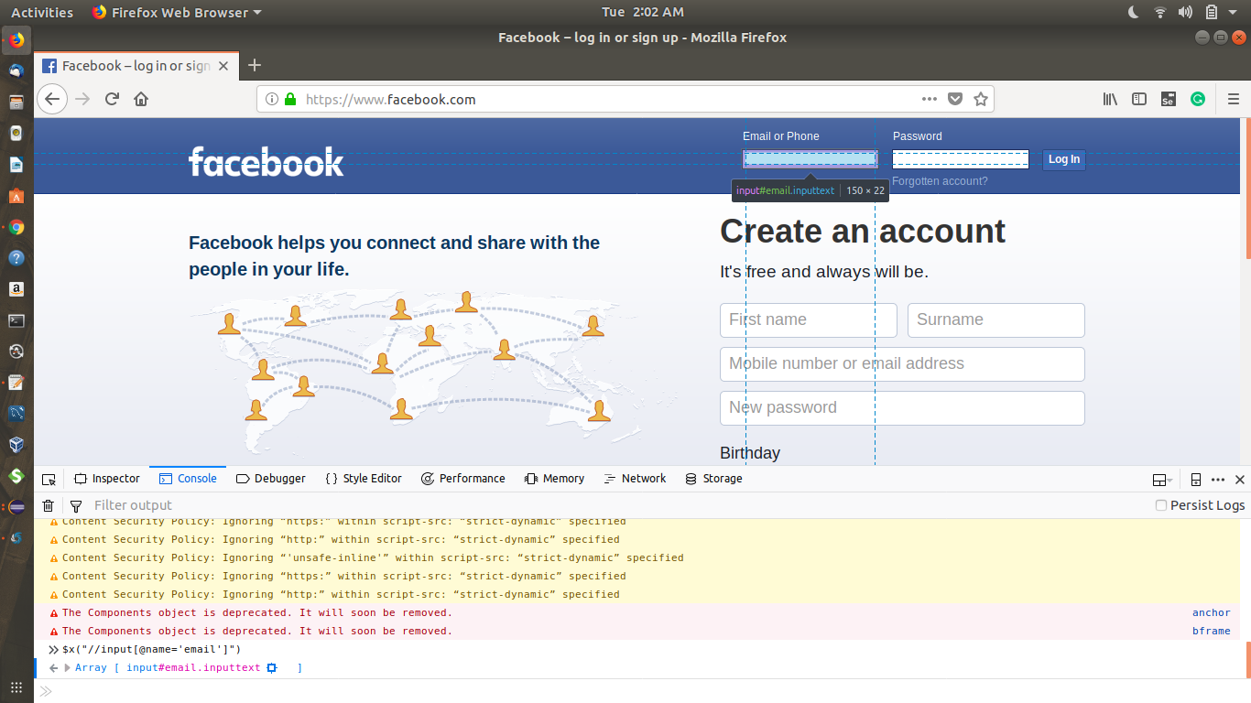
Validate Customized Xpath

Slide 39
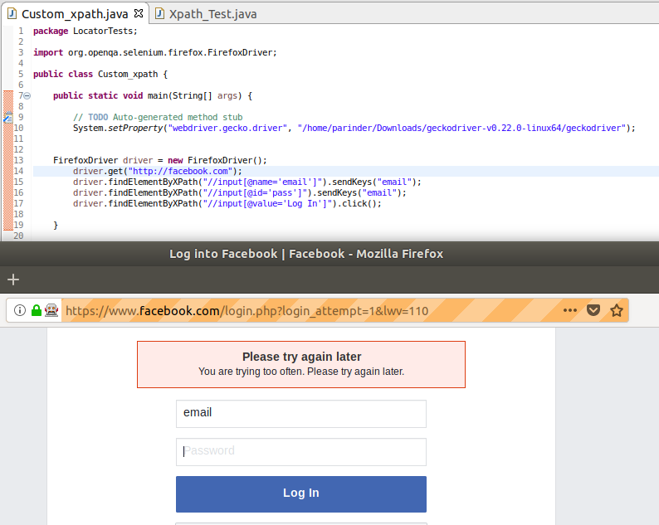
Generating Customized Xpath From HTML Attributes - code

Slide 40
Generating Customized Css From HTML Attributes
Steps:
First inspect the element & analysis the highligted link.
<input class="inputtext" name="email" id="email" value="parindersinghraina" tabindex="1" data-testid="royal_email" type="email">
In the above HTML code,
Input = Tagname
name = Attribute
email = Value
Css = Tagname [Attribute = 'value']
Choose the Unique Attribute and generate the xpath.
In some cases, the value(alpha numeric) can be changed during refresh or reload the page. In that case choose the unique attribute.
Example: There is one element in facebook login page: "Log In" Button.
<input value="Log In" aria-label="Log In" tabindex="4" data-testid="royal_login_button" id="u_0_2" type="submit">
In the above HTML code, there is alpha numeric value of attribute "id", it can be change during reload or refresh the page. In this case choose the unique one like
Value = 'Log In' - it's unique because there is no element like Log In exist in the page, if we go for type="submit" So there is one more button in the webpage called "Create Account" It has same Attribute with same value.

Slide 41
Generating Customized CSS From HTML Attributes
HTML CODE FOR ELEMENT = Email
<input class="inputtext" name="email" id="email" value="parindersinghraina" tabindex="1" data-testid="royal_email" type="email">
Css = input[name='email'] OR Css = tagname#id -> input#email OR Css= tagname.classname -> input.inputtext
HTML CODE FOR ELEMENT = Password
<input class="inputtext" name="pass" id="pass" tabindex="2" data-testid="royal_pass" type="password">
Css= input[id='pass']
HTML CODE FOR ELEMENT = Log In
<input value="Log In" aria-label="Log In" tabindex="4" data-testid="royal_login_button" id="u_0_2" type="submit">
Css= [value='Log In']
In above Css, Not sure about the TagName
If you are not sure about tagname use don't use * leave that place.

Slide 42
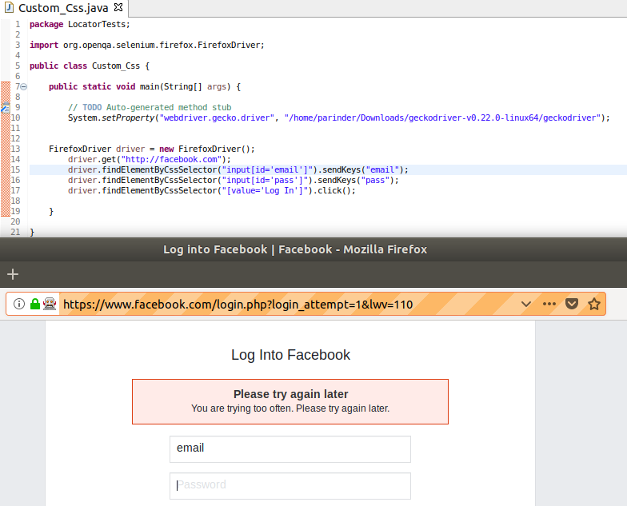
Generating Customized CSS From HTML Attributes

Slide 43
Regular Expression – Xpath & Css
In the highlighted link most of the time, alpha numeric values changes: <input value="Log In" aria-label="Log In" tabindex="4" data-testid="royal_login_button" id="u_0_2" type="submit">
To overwrite all these kind of errors we use regular expression.
Sometime we use regular expression, if we have long value "ERDEFDSSDDRRFDDFFDEEDF".
Syntax: xpath: //tagname[contains(@attribute, 'value')] CSS: tagname[Attribute*='value']

Slide 44
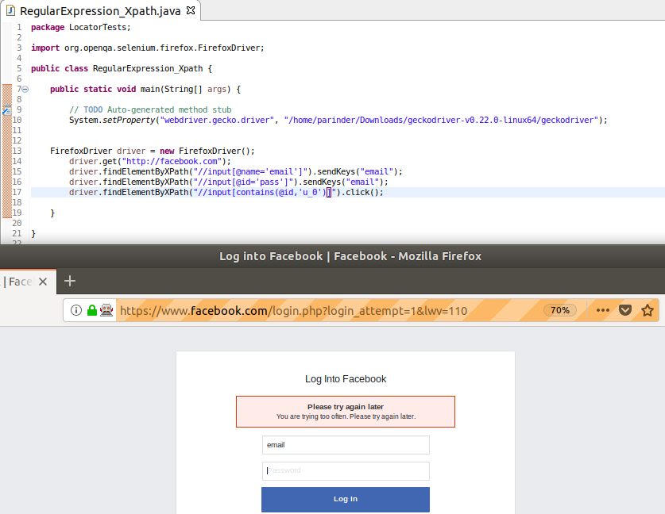
Regular Expression – Xpath & Css
driver.findElementByXpath("//input[contains(@id, 'u_0')]").click();

Slide 45
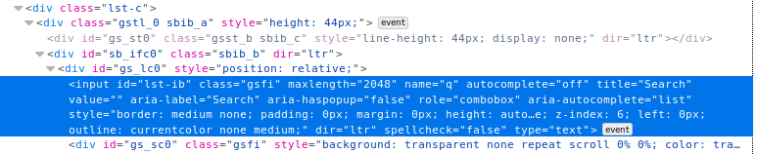
Identify Xpath with Parent- Child Traverse Relationship
If you are unable to select the choose attribute or don't have unique attitibute, tagname or value is not constant.
Go for the parent-child relationship and make effective Xpath.
Always follow the arrows, if pin down it's mean the lower tag is child of that open or down arrow tag. And it same for other open/down arrows, we consider as grand parents to them.
//div[@class='lst-c']/div/div/div/input - Xpath for Google TextField

Slide 46
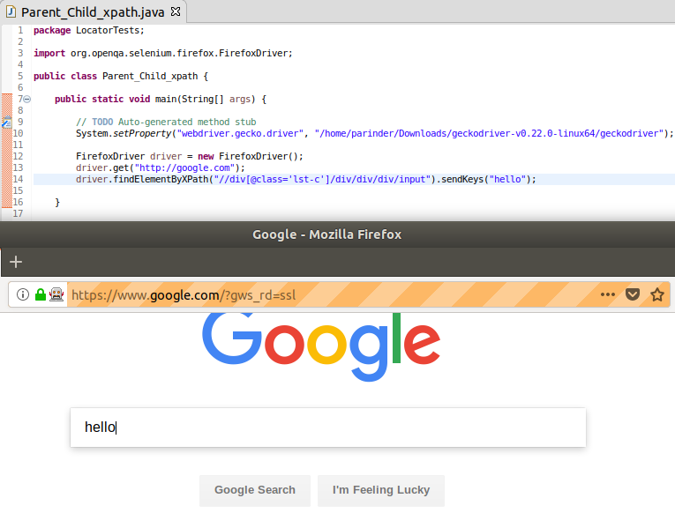
Identify Xpath with Parent- Child Traverse Relationship

Slide 47
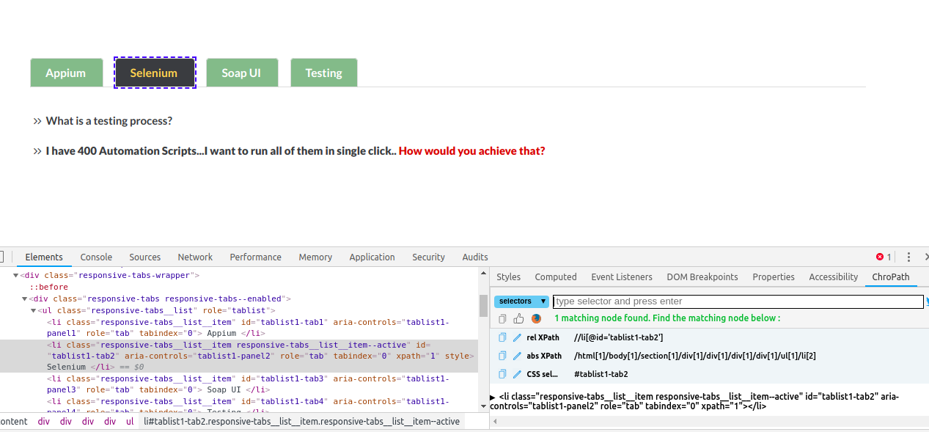
Interview Questions - Selenium
Difference between Relative & Absolute xpath ?
Relative Xpath – Dosen't Depend on Parent Node.
Absolute Xpath - It's Depend on the Parents Node.

Slide 48
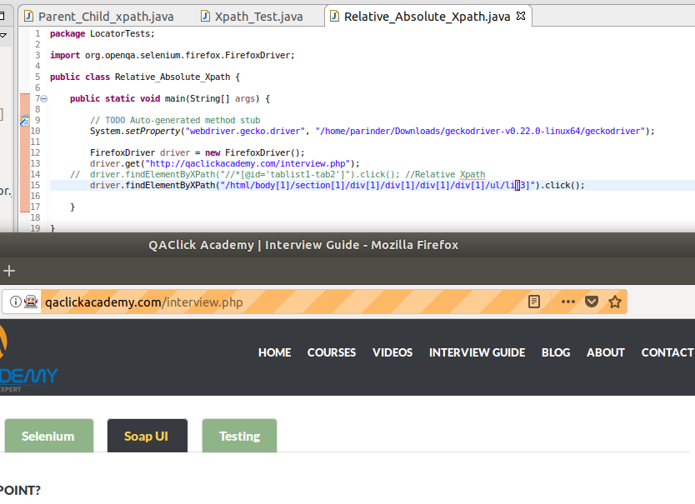
Relative & Absolute Xpath - Code

Slide 49
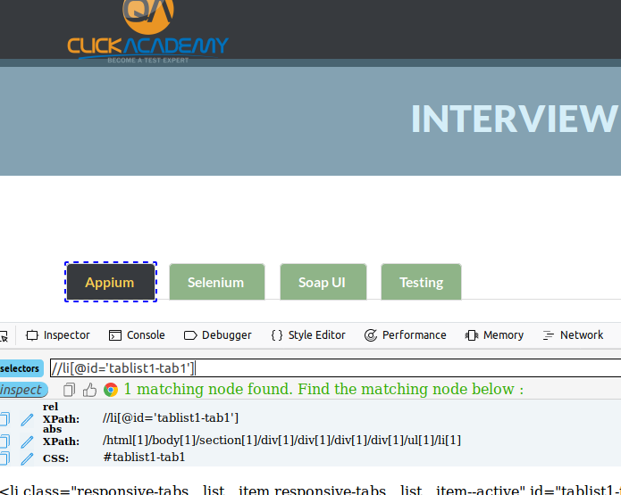
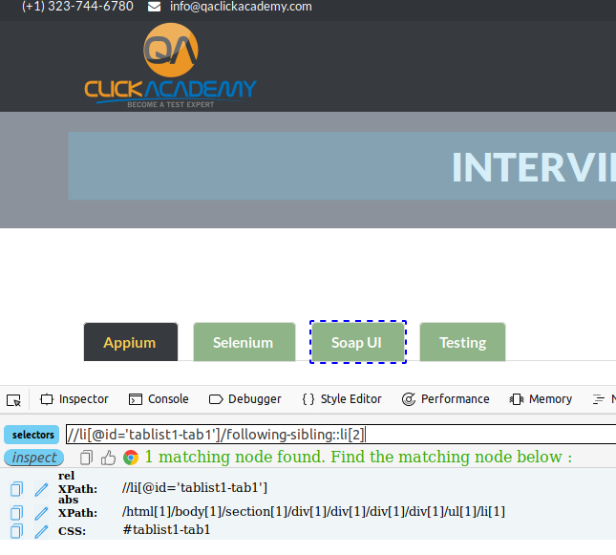
Identify the Siblings Xpath
Identify the Siblings means, identify the element in same child class.
Syntax: //[xpath_sibling_element]/following-sibling::next_sibling_tag_& number

Slide 50
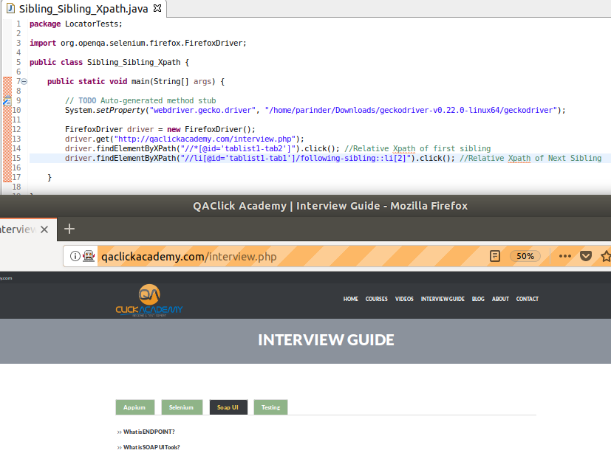
Identify the Siblings Xpath - Code

Slide 51
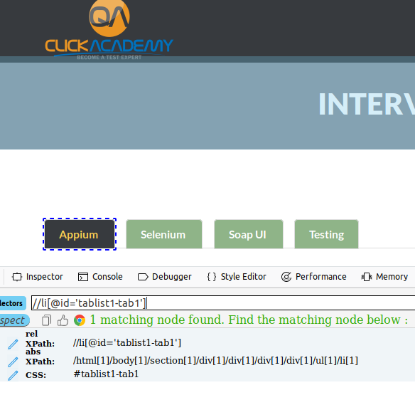
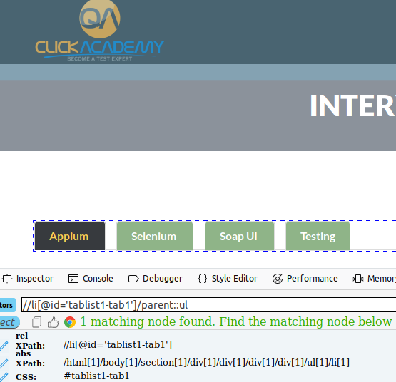
Identify the Parent from Child Xpath
This function help to traverse from child to parent.
Syntax: //[xpath_of_child]/parent:: tagname_parent

Slide 52
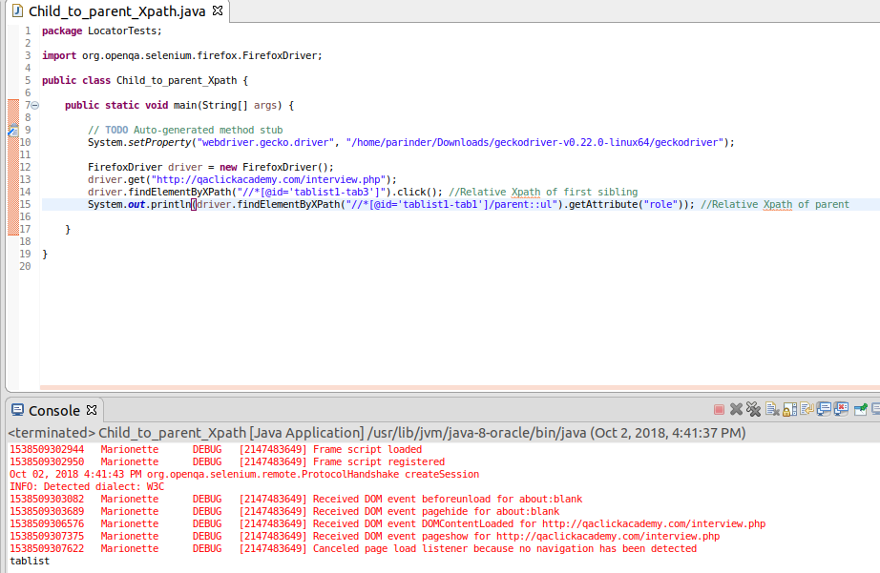
Identify the Parent from Child Xpath
Xpath Vs Css – the major Differenece is Css don’t have traverse feature as like xpath

Slide 53
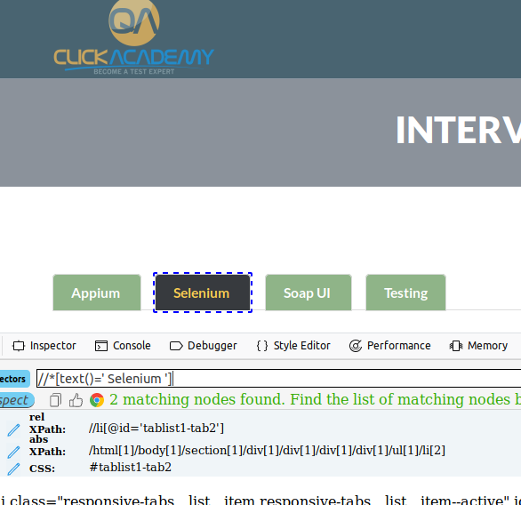
How to identify Element with Text Using Xpath
This Scenario will be apply when you don't have any attribute then go for text.
Syntax: //tagname[text()= ' text_name ']

Slide 54
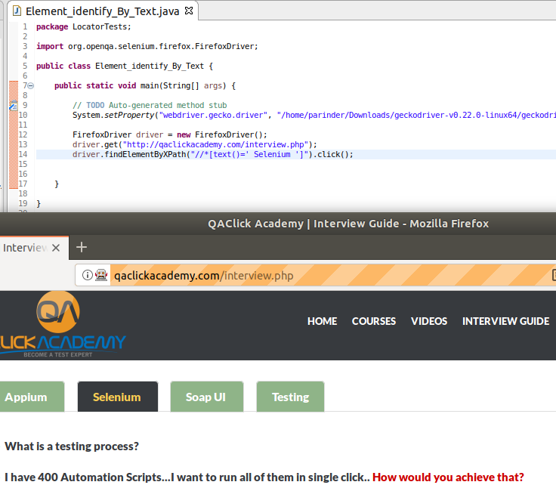
How to identify Element with Text Using Xpath
driver.findElementByXpath("//*[text()=' Selenium ']").click();

Slide 55
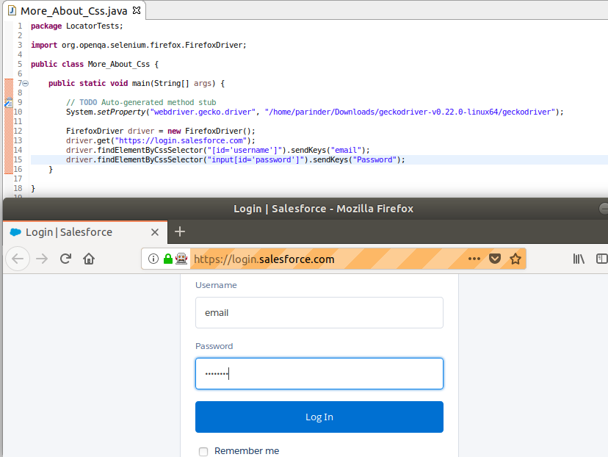
More About CSS Locator

Slide 56
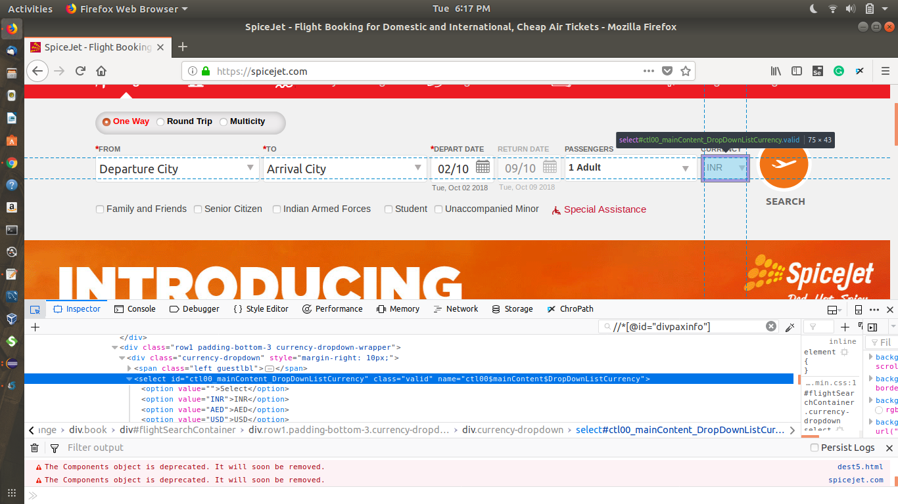
Handling Static Drop-Down
Static Drop-Downs refers to the tradational way of drop down.
Static Drop Down always have <select> tagname.
We can manage the static Drop Drowns by creating an object of Select class which already defined in the java library.
Syntax: Select obj-name = new Select (findelementby - Locator); obj-name.selectBy(values/index/text)("parameter");

Slide 57
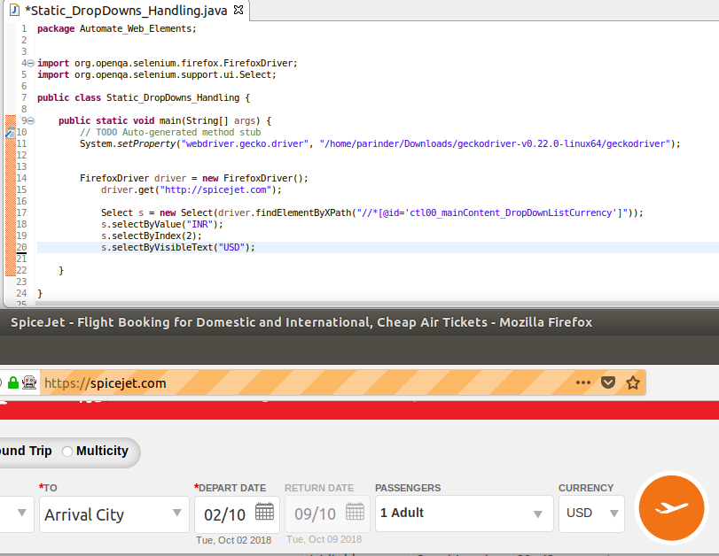
Handling Static Drop-Down - Code

Slide 58
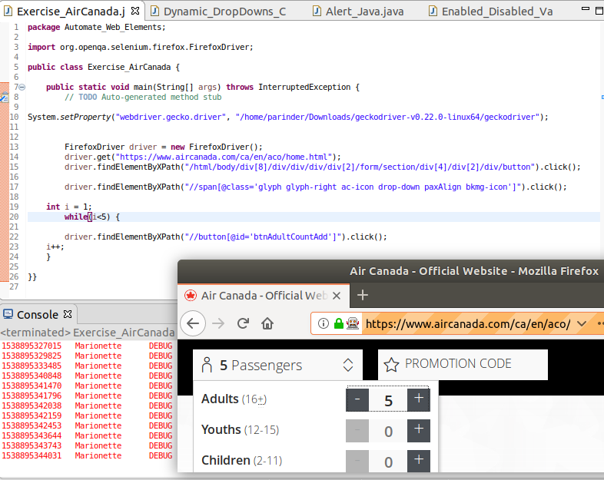
Handling Dynamic Drop Downs
Dynamic DropDowns Have no Select class.
Simply inspect the element and apply the functions on it.
Sometime follow the parent-child concept.

Slide 59


Handling Dynamic Drop Downs-Code

Slide 60

Handle Auto Suggestive DropDowns
Handling with Auto Suggestive DropDowns with Keyword operations.
Because when you try to inspect the suggestive list the list disapper.
So apply keyword operations over there and select the particular option.
But there is one problem, Selenium never capture the hidden elements.
In this case we are not able to get that text and validate.
We just select that particular option.

Slide 61


How To Identify Hidden Element.
We execute a program but the output of that is only select the option but not print that selected option.
The reason on left side screenshot, there is hidden element.
That’s the selenium not able to deal with it.
Solution is JavaScript.

Slide 62

Solution - Hidden Element JavascriptExecutor
Why Javascript ? - Because selenium not extract the hidden element and Javascript DOM can extract hidden element (Ajax implementation).
JavascriptExecutor – class in selenium which allow us to write script in java code.
Simply create JavascriptExecutor object for driver and apply operations.
Inspect element in Javascript DOM HTML code: document.getElementById(\" \"). value;

Slide 63

Solution - Hidden Element JavascriptExecutor Code

Slide 64

Handling Cheakboxes
Checkbox testing scenerio is pretty simple as inspect Element.
In this we use special function called ".is selected()" to validate the checkbox is marked or unmarked.
If checkbox mark , the output is true and vice-versa
During Inspect click on Checkbox always

Slide 65

Handling Cheakboxes - Code
Simply inspect the element by id.
Apply "isSelected()" to validate the checkbox is marked or not.
Apply code, driver.findElementByid(" ").click();
Then Again validate the checkbox by ".isSelected()"

Slide 66

Handling RadioButtons – Customize Xpath
During Radio Button handling, we need to focus on unique attribute.
Because In Radio Button's script, most of the attributes have same value.
As per Screenshot, only value attribute has different value, but name and type have same value for all Radio Button.
These same value attribute helps for counting the radio buttons present in particular block.

Slide 67

Handling Radio-Buttons: Code
Inspect the radio button, by xpath with unique attribute("value").
driver.findElementByXPath("attribute").click();
Count the number of radio button present in the webpage by common attribute with size() function.
driver.findElementByXpath("common_attribute").size();
size() is available when write Elements instead of Element.

Slide 68

Handing Radio Button – Dynamically
If we don't have unique attribute, then used different approaches as mention in code.

Slide 69

Handing Radio Button – Dynamically Code
getIndex() is available when write Elements instead of Element.

Slide 70


Alerts – Types & Handling
Alerts - Types
Alerts don't have html code, If any alert/pop up have no html code that relate to Java based popup/alert.
If any alert have html code then it is web based alert.
Handling –Alerts
If there is no Html code then, apply predefined class alert and switch driver to alert.
First inspect the button which produce alert.
driver.switchTo().alert().accept(); // click on Yes/ok Button
driver.switchTo().alert().dismiss(); // click on cancel Button
driver.switchTo().alert().getText(); // Display msg of Popup
driver.switchTo().alert().sendKeys(); // Write something on alert box.
If there is Html code, then go for driver staggery and inspect the elements.
No HTML Code
HTML Code

Slide 71

Alert Handling - Code

Slide 72


Validate - Web Elements
In first Case, there is website www.makemytrip.com, if we click on multicity Radio Button the return date element disappeared.
Now we validate the return-date element is that exists or not.
By simple method called, isDisplayed();
Note: isDisplayed() is work only if that element present in code not visible..

Slide 73

Validate Web Elements - Code
IsDisplayed() - has Boolean output, if element appear the output will be true otherwise it false.
IsDisplayed()- method is used when particular object is in code base but it is in visible mode / not.
If you want to validate the object which is present in webpage or code base use size();

Slide 74

Validate Web Elements
In first Case, there is website www.makemytrip.com, if we click on OneDay Trip Button the return date element disappeared.
Now we validate the return-date element is that enable or not.
By simple method called, isEnabled();

Slide 75


Validate Web Elements -Code
IsSelected() - validate that the element in the webpage is selected or not.
It's output in boolean, true or false.

Slide 76
Exercise: Select Adults 5 in Air Canada Site

Slide 77
Assert – Basic Idea
Assertions: Assertions verify that the state of the application is same to what we are expecting.
In the Example of makemytrip.com , where we display the return Date element.
We apply assertTrue & assertFalse in that code and validate the result.
If you apply asserTrue, and the output is true then code will run otherwise it will show error.
If use assertFalse, and the output is true then code will stop and show error.
So assertion always follow is our expecting result match with that particular assertion which we applied.

Slide 78
Assert – Basic Idea Code

Slide 79
Synchronization in Selenium
Implicit Wait
Explicit Wait
Thread.Sleep();
Fluent Wait

Slide 80
Implicit Wait
An implicit wait tells WebDriver to poll the DOM for a certain amount of time when trying to find an element or elements if they are not immediately available.
In simple words, wait for n-seconds before you throw exception.
Example: In most of the travel websites or search engines, the website take sometime for displaying the result after fill up all the details. If there is no wait time then webdriver shows error – not found that element.
If you apply implicit wait 5 seconds and page loaded in 2 seconds, then it start working (2nd sec.) not wait for other 3 seconds that’s how implicit wait works.
If your page take more time that mention in implicit wait, then it will show error.
NOTE: implicit wait works globally (for whole script)

Slide 81


Implicit Wait - Code
Without Implicit wait()
With Implicitwait()
driver.manage().timeouts().implicitlyWait(20, TimeUnit.SECONDS);

Slide 82
Explicit Wait
An explicit wait makes WebDriver wait for a certain condition to occur before proceeding further with execution.
Why we need Explixit wait if we have implicit wait ?
If you search Hotels in multi cities and your implicit time is 10 seconds and 3 cities out of 5 details not display because of some error still code take 10 seconds for each city even it is ot working, it degrade the performance of the testing.
Solution is Explicit wait() - It applicable only the specific scenerio instead of all.
There is one predefined class WebDriverWait in selenium library which is used for explicit wait.
Create an obejct of WebDriverWait class and defined driver a wait time.

Slide 83

Explicit Wait - Code
Create an obejct for WebDriverWait() class WebDriverWait delay = new WebDriverWait(driver, 20); delay.untill(ExpectedConditions. _Apply Suitable Cond.);

Slide 84
Other Wait() Methods – Not Prefferable
Thread.Sleep() - It's not part of selenium, it's part of java – it hold the execution.
Fluent Wait() - https://www.testingexcellence.com/webdriver-explicit-implicit-fluent-wait/

Slide 85
Handling Ajax/Mouse Interactions
Handling of mouse/keyword interactions with selenium is done by Action Class.

Slide 86

Move Mouse Handling
Move Mouse to web element testing/handling, just move to particular element and test the pop-up will display or not.
Inspect the source element and apply in Action class.
Create object of Actions class and select the desire element for perform action on it.
After action on particular element we will build and perform that function by build() & perform().

Slide 87

Move Mouse Handling- code
Inspect the element.
Create object of Actions Class & pass driver as argument.
Apply function on that object & path of that element.
Then build that function by build() and execute that by perform().

Slide 88
Composite Functions
Perform multiple function in single line of code.
Move Mouse To Text Box.
Type Text In Capital Letters.
Select That Particular Text.
Perform Right Click There.

Slide 89

Composite Functions - Code

Slide 90

Window Handling – Child Window
Child Window refers to whenever we work on current window (called parent window) and click on some hyper-link and new window or new tab open, that window called child window.
Handling on child window, it’s little bit tricky.
Selenium don't understand the child window, it stick with parent window always.
We need to switch driver from parent window to child by using switchTo() function.
Before that we handles all the windows and grab the id's of each of them. Because during switchTo().window function enter that particular window id which we want to handle.
Use iterator() method to move from one window to another in the set of windows' ids.
Exapmle: Go to Google SingUp page and click on Help hyper-text and new window will open and test on that window, capture the title of that page.

Slide 91

Window Handling – Child Window Code
Steps:
Inspect the hyper-text element.
For validate get title of that page.
Store the number of windows/tabs open by windowHandles().
Then iterate that store variable with the help of iterator.
Move one by one to destination window by next() and store the id of windows too.
Then switch to that window by switchTo().window (window_id);
Then get tittle of that child window and validate.

Slide 92

IFrames Handling
IFrame is a web page which is embedded in another web page or an HTML document embedded inside another HTML document.
The IFrame is often used to insert content from another source, such as an advertisement, into a Web page. The <iframe> tag specifies an inline frame.
We can identify the iframes using methods given below:
Right click on the element, If you find the option like 'This Frame' then it is an iframe.(Please refer the above diagram)
Right click on the page and click 'View Page Source' and Search with the 'iframe', if you can find any tag name with the 'iframe' then it is meaning to say the page consisting an iframe.
IFrame is on the top of application so selenium not identify it so we need to switch from driver to frame by switchTo().Frame();
Basically, we can switch over the elements in frames using 3 ways.
By Index
By Name or Id
By Web Element

Slide 93

IFrame Handling - Code
In this code, count the number of frames present in the webpage.
Driver switch to frame and double click on the element.
After done with frame, need to switch back webdriver from frame to driver with defaultcontent().
Now you can do operation with other web elements which are present in webpage.

Slide 94

IFrame Handling With Drag Drop - Code

Slide 95
Run Time IFrame Handling – I'm not a Robot
How to Handle Multiple Frames ?
First Identify the number of iframes.
After perform operation on that frame other frame open.
In that case we need to switch frame to driver in default and then go for that frame.
Inspect the first iframe and inspect particular element.

Slide 96

Run Time IFrame Handling – I'm not a Robot

Slide 97

Exercise #1 – Links Count In The Web Page

Slide 98

Exercise #2 – Links Count In Footer Only
In this case, we use Limiting webdriver scope concept because driver capture all the information which present in the webpage.
But now we just focus on footer of the webpage.
So we create sub-driver / WebElement which focus on that particular area and capture the information.
WebElement foot_drv = driver.findElement ----;

Slide 99

Exercise #2 – Links Count In Footer -Code

Slide 100


Exercise #3
1
2
Count links in particular columns.
Check all the links are open or not.
(Remember: When you click on link, that link open at same page not in new tab or window).How to open links in separate tab ?
When we apply Ctrl+Click/Enter any link it will always open in new tab.
And always use sendKeys() method for keyboad operations instead of click.

Slide 101

Exercise #3 - Code

Slide 102

Exercise# 3 – Get Title Of All Open Tabs in Previous Task
hasnext()- Tells us whether next index is present or not.
next() - It actually move to next

Slide 103

Handling Calendar UI - Code

Slide 104

Handle Table Grids
In Table Testing, most of the elements have same Css.
Always tried to find parent Css of that particular element.
Table elements try to deal with WebElement instead of driver because we need to deal with particular part instead of webpage.
Note: One approach for move to parent – child
[<Locator> ] tagname: nth-child(cild_no. Like 3/4/5)

Slide 105

Handle Table Grids - Code

Slide 106

HTTP-Certifications Handling
During HTTP – Handlings, there is one class in selenium ChromeOption which helps to handle and merge with capability.
There is class Desired Capabilities class which help to customize browser.
Define DesiredCaabilities class and creating object & Import Capabilities and apply functions like "acceptInsecureCerts()".
Then move that particular function to ChromeOption.
Apply that ChromeOption object pass an argument to webdriver("chromeoption obj").

Slide 107

HTTP-Certifications Handling Code

Slide 108

Cookies Handling
driver.manage().deleteAllCookies();
Exercise: Delete Particular Cookie ! Verify Redirect to Login Page !

Slide 109
Screenshot In Selenium
We need to cast the driver object to TakeScreenshot – method. File src = (TakeScreenshot(driver).getScreenshotAs(OutputType.FILE);
Now it's time to move that output file from source object to local machine. FileUtils.copyFile(src,new file("path"));

Slide 110


Slide 111


Slide 112

Framework - Selenium
Selenium Framework is a code structure that helps to make code maintenance easy.
Without frameworks, we will place the “code” as well as “data” in the same place which is neither re-usable nor readable.
Using Frameworks, produce beneficial outcomes like increased code re-usage, higher portability, reduced script maintenance cost, higher code readability, etc.

Slide 113

TestNG - Introduction
TestNG is an automation testing framework in which NG stands for "Next Generation". TestNG is inspired from JUnit which uses the annotations (@).
Using TestNG you can generate a proper report, and you can easily come to know how many test cases are passed, failed and skipped.
Default Selenium tests do not generate a proper format for the test results. Using TestNG we can generate test results.
There are three major advantages of TestNG over JUnit:
Annotations are easier to understand
Test cases can be grouped more easily
Parallel testing is possible

Slide 114


TestNG – Without Java Compiler
In Back-end, TestNG depend on Java But In Front-end there is no dependency on Java.
Run test in TestNG – need to use @Test and import lib. and run program as TestNG
Number of @Test define the number of tests.
If you have 3 tests you need to define 3 @Test annotations in the program before test/method.

Slide 115

Multiple Test Cases – Single Class
If you have 3 tests you need to define 3 @Test annotations in the program before test/method.

Slide 116
Xml File - TestNG
Create xml – Right click on TestNG project > TestNG > Convert ToT estNg
Xml format - Test Suite -> Test Folder -> Test Cases
Example: Test Suite – Loan Dept. Test Folder – Personal Loan / Home Loan/ Car Loan Test Case – Personal Loan Customer Login Validation / Home Loan Cust. Login Validation..
If we have two test case for personal loan –test folder under Loan dept. - suite then what we can do ?
We aren't go to each and every test and run them, that's not happen in framework.
We develop xml according to scenario.
Run that particular xml and get result of all multiple test cases a single time.
If you want to exclude particular test from folder you can do that just modify that particular class with tag names <methods>, <exclude>, <include>

Slide 117


Xml File - TestNG
Here we have two tests in Xml_Concept package.
So we consider suite as Loan Dept. , test – Personal loan and Cases – valid & invalid login
Create xml first and then develop it.

Slide 118

Run Multiple Tests in TestNG -xml
After develop/ create xml – run testng.xml as TestNG Suite and get output of all test case without run them one by one

Slide 119

Prioritizing Test Cases- xml example
In this Scenario, we have 3 test folders –car, home & personal under loan suite.
Scenario 1: Client wants to Run all test cases in single time.
Scenario 2: Client don't want to run tests of personal loan & run rest of all.
Scenario 3: Run only Home loan but In Home loan, client want to run only mobile & web test cases.
Scenario 4: In car loan, client wants to run API test case only.

Slide 120

Scenario 1

Slide 121

Scenario 2

Slide 122

Scenario 3

Slide 123

Scenario 4

Slide 124
Regex & Package Level Execution -TestNG
Regex in TestNG is helpful to efficient any suite testing. With the help of regex we can <exclude> or <include> any common name test cases.
Synatx: <include name = "mobile.*"/>
Example: The above syntax will execute all the test cases which having "mobile" word.
Package Level Execution: Package execution is done by the modification in xml code.
Instead of test folders we define package name and run all test cases.
This kind of approach use in regression testing.

Slide 125


Regex & Package Level Execution –TestNG Code

Slide 126
Annotations : @BeforeTest & @AfterTest
@BeforeSuite: The annotated method will be run before all tests in this suite have run.
@AfterSuite: The annotated method will be run after all tests in this suite have run.
@BeforeTest: The annotated method will be run before any test method belonging to the classes inside the <test> tag is run.
@AfterTest: The annotated method will be run after all the test methods belonging to the classes inside the <test> tag have run.
@BeforeGroups: The list of groups that this configuration method will run before. This method is guaranteed to run shortly before the first test method that belongs to any of these groups is invoked.
@AfterGroups: The list of groups that this configuration method will run after. This method is guaranteed to run shortly after the last test method that belongs to any of these groups is invoked.
@BeforeClass: The annotated method will be run before the first test method in the current class is invoked.
@AfterClass: The annotated method will be run after all the test methods in the current class have been run.
@BeforeMethod: The annotated method will be run before each test method.
@AfterMethod: The annotated method will be run after each test method.

Slide 127

Annotations : @BeforeTest

Slide 128

Annotations : @AfterTest

Slide 129

@BeforeTest vs @BeforeMethod
@BeforeTest : It will call Only once, before Test method.
@BeforeMethod It will call Every time before Test Method..

Slide 130
Groups Functionality - TestNG
Groups: Group functionality is used when we don't want to define test methods separately in different classes (depending upon functionality).
Example: If client wants to test only "mobile login" tests for all loan departments. Instead of writing all test tags in xml use group tag. Simply define group_tag after @Test.
Syntax: @__(groups={"TagName"}) in Java Code
Syntax: In Xml,
<test><groups> <run> <include/exclude name="TagName" /> </run> </groups> ...
Group functionality is helpful in Regression testing

Slide 131

Groups Functionality - Code
Execute "Mobile_Loan_Login" from all departments.

Slide 132
Annotations Helper Attributes
TestNG Dependencies with annotations: Sometimes, you may need to invoke methods in a test case in a certain order. TestNG allows you to specify dependencies either with:
Using attribute dependsOnMethods("method_name") in @Test annotations, OR
Using attribute dependsOnGroups in @Test annotations
Dependencies with XML <-Click
Enabled: Sometimes, you may need to enable or disable test. If you don’t require test for running you can disable it by pass value false @Test(enabled=false) - It'll disable the particular test.
TimeOut: If your test case contain any heavy website and it might take to load so you can apply waiting time for delay. @Test(timeOut=5000)

Slide 133

Annotations Helper Attributes- Code

Slide 134

Parameterizing - TestNG
As we create software, we always wish it should work differently with a different set of data. When it comes to Testing the same piece of software, we can't be unfair to test it with just one set of data. Here again, we need to verify that our system is taking all set of combinations which it expected to support.
Here comes Parameterization in the picture. To pass multiple data to the application at runtime, we need to parameterize our test scripts.
There are two ways by which we can achieve parameterization in TestNG
With the help of Parameters annotation and TestNG XML file.
With the help of DataProvider annotation.

Slide 135

Parameterizing - TestNG Code

Slide 136

Listeners Interface - TestNG
Listener is defined as interface that modifies the default TestNG's behavior. As the name suggests Listeners "listen" to the event defined in the selenium script and behave accordingly. It is used in selenium by implementing Listeners Interface. It allows customizing TestNG reports or logs. There are many types of TestNG listeners available.

Slide 137
Listeners Interface - TestNG
ITestListener(which implements testing listners) has following methods
OnStart- OnStart method is called when any Test starts.
onTestSuccess- onTestSuccess method is called on the success of any Test.
onTestFailure- onTestFailure method is called on the failure of any Test.
onTestSkipped- onTestSkipped method is called on skipped of any Test.
onTestFailedButWithinSuccessPercentage- method is called each time Test fails but is within success percentage.
onFinish- onFinish method is called after all Tests are executed.
In xml – always define after the suite: <listners> <listner class-name= "package_name.file(listnerfilename)"/> </listners>
In Code: If you want to track all the test withname, go to listner code and pass method getName() with result.

Slide 138

Listeners Interface – TestNG Code

Slide 139

Listeners Interface – TestNG Code (Get Name of Test)

Slide 140

Running Test In Parallel & Generating Report
If we have many tests, so we can defined in the system – how any tests run at the same time or parallelly.
There are couple of attributes like parallel & thread-count (number of tests that are run at the same time).
In the XML: <suites name= " --- " parallel="name_Classes" thread-count="number">
Index.html - contains the report of all the tests.

Slide 141
Global Environmental Variable
Create file with the extension properties. There is one class Properties which help to perform this kimd of operations.
Because with Resusable things like username and passwords, URLs, code, key and resources make script complex and unprofessional.
All these components(Base URL and Key) define in that properties extension file with some rules. Load that particular properties by FileInputStream class.

Slide 142

Global Environmental Variable

Slide 143

Maven In Framework Development

Slide 144

Maven Intro & Why Maven ?
Apache Maven is a software project management and build management tool for Java Frameworks.
Why Maven ?
Central repository to get dependencies – It has central repository which consist of all the jar files for different platforms. It help to avoid add the external jars. Just write 4 line code and it will fetch all the required jars from its own repository. All the jars download in our system in m2 directory. In eclipse: Go to windows>preferences>maven>user setting
Maintaining common structure across the organization -There is one file called pom.xml which maintane the sturucture of partocular project like testing, development, maintance.
Flexibility in Integrating with CI tools -
Plugins for Test framework execution -
NOTE: Install Maven

Slide 145
Maven Terminologies
Artifact: An artifact is a file, usually a JAR, that gets deployed to a Maven repository.
GroupId: groupId will identify your project uniquely across all projects,
archetype:generate ; Generates a new project from an archetype (template/skelton)

Slide 146

Create Maven Project
-D : It used to identify the parameters.
-DgroupID – Provide unique Id to project.
-DartifactId – It's Jar and Name of the project.
-DarchetypeArtifactID – It's used to select the type of template used in the project. QuickStart is the most common template which is used for testing.

Slide 147

Integrate Maven with Eclipse
When we create maven project, there is no .classpath & .project files include in the folder.
So when we integrate any project with eclipse we need to create these two files.
Steps:
First identify the location of project.
Go to terminal & write command: mvn eclipse:eclipse
After that, import that project into eclipse.

Slide 148



Create Maven Project

Slide 149

Understanding pom.xml & Surefire plugin
We are create maven project and create 2 java class files one for selenium and other for Rest API test.
But there is no jars for that project. Now the role of pom.xml comes in the picture.
In this we add <dependency> for related project and get jars.
There is one feature is also available in maven for executing multiple test in the same time called maven-surefire-plugin , this will place before <dependency> tags
If you want to run selected tests. So create xml file same as TestNG and trigger them as per requirement.
Note: ✍If There Is No Test Word In The End Of The Class Name Maven Will Not Execute It.

Slide 150
Maven Commands
mvn clean - Command delete all previous files/build in the projects.
mvn compile - Check syntax error (when you work in jenkins eclipse not show error so that command is work like hero.
mvn test - This command used to execute all the tests because you have maven-surefire-plugin.

Slide 151

Understanding pom.xml & Surefire plugin - Code

Slide 152

TestNG xml file in Maven
If you want to run selected tests. So create xml file same as TestNG and trigger them as per requirement.
We need to update pom.xml also. Apply <configuration> tag for xml execution.
You need to apply the name same as your xml file which you want to execute.

Slide 153

Switching The Tests with Maven
If we have different type of testNG.xml files for smoke testing, regression testing and others.
So we don't need to change file name everytime for the execution. We will make profiles for each and every type of testing with its xml file.
There is tag called <profiles> <profile> </profile> <id></id></profiles> It's at the top of the <build> tags.
Enter all the <build> tags over there and change the testng.xml file name.
In Terminal Run As mvn test –P<id>

Slide 154


Slide 155
Jenkins
Continuous integration is a process in which all development work is integrated as early as possible. The resulting artifacts are automatically created and tested. This process allows to identify errors as early as possible.
Jenkins is a popular open source tool to perform continuous integration and build automation.
The basic functionality of Jenkins is to execute a predefined list of steps, e.g. to compile Java source code and build a JAR from the resulting classes.
The trigger for this execution can be time or event based.
Example: If we have 1000 of tests which take 7 hours so we make a schedule job throught jenkins which execute all the tests during that particular time.
Installation
Parent Directory - /var/lib/jenkins
Permission - chown -R jenkins /var/lib/jenkins/

Slide 156
Mobile – Automation Testing

Slide 158
Performance Testing In Selenium
Performance Testing is a type of testing to ensure software applications will perform well under their expected workload.
The focus of Performance Testing is checking a software program's
Speed - Determines whether the application responds quickly
Scalability - Determines maximum user load the software application can handle.
Stability - Determines if the application is stable under varying loads

Slide 159

HtmlUnitDriver
HTMLUnitDriver is not like other web browser driver, it is light weight and headless. It will not display graphic user interface at run time, this can save a lot of system resources and make your test application run faster. But it is a full feature browser driver.
Support HtmlUnit web browser. HtmlUnit is a pure java headless web browser.
Support both Http and Https protocal.
Support Cookies, JavaScript and Proxy server.
Can interact with html response page such as submit form, click links and walk through the page dom tree.
Can simulate both Get and Post web request method.
Request header name and values can be customized.

Slide 160
Automation Load Testing In Selenium

Slide 161


Slide 162

Cucumber - Intro
Cucumber is a tool that supports Behavior Driven Development (BDD). It offers a way to write tests that anybody can understand, regardless of their technical knowledge.
In BDD, users (business analysts, product owners) first write scenarios or acceptance tests that describes the behavior of the system from the customer's perspective, for review and sign-off by the product owners before developers write their codes.
The 2 files required to execute a Cucumber test scenario are
Features: A feature would describe the current test script which has to be executed.
Step Definition: Step definition maps the Test Case Steps in the feature files(introduced by Given/When/Then) to code.

Slide 163
Cucumber Framework
Behaviors Driven Development(BDD): In BDD, whatever you write must go into Given-When-Then steps.
TestCases Specifications in Behaviour Driven Development :
Steps:
Testcases should be defined in a Business level by following a ubiquitous language. [ Ubiquitous language is a (semi-)formal language that is shared by all members of a software development team  both software developers and non-technical personnel].
Syntax : In order to(Achieve something)-> Business outcome
As a (Role)
I want to Do this

Slide 164
Cucumber Framework
Example:
In order to Pay Credit Card Payment As a NetBanking sole owner who have credit section access I want to Navigate to credit card section, Enter amount and process my Payment
Steps :
Its time to Decide what Test cases are sufficient to certify Business Scenario working
Given (what you need to have to perform action), -Prerequists
When (performs action)- Action
Then (the desired outcome for the user).- Validation

Slide 165
Advantages of Cucumber Framework
This can be used as Standard Template where all QA can stick to one common standards of defining Testcases
Each Scenario reflects a Business Value
We can estimate the Test coverage happened for Each Business outcome by going through Test Cases
We can tag these Annotations to Selenium Automation and execute the Business Testcases
Common Standardised Testcase template for both Manual and Automation testing

Slide 166

Gherkin - Intro
Gherkin is the format for cucumber specifications.
It is a domain specific language which helps you to describe business behavior without the need to go into detail of implementation.
This text acts as documentation and skeleton of your automated tests.
Gherkin Syntax:
Feature: Title of the Scenario Given [Preconditions or Initial Context] When [Event or Trigger] Then [Expected output]

Slide 167


Why Gherkin ?
<Before Gherkin After>

Slide 168

Automation Code – Cucumber Framework
Steps:
Create Feature file with extension .feature where business analyst or QA team write the test case in semi-formal language.
Feature: Scenario: Given When Then
Convert feature file into java code by "tidyGherkin" app/get from console

Slide 169

Automation Code – Cucumber Framework
Update pom.xml file with cucumber required jars/dependencies - cucumber-java & cucumber-Junit.

Slide 170

Automation Code – Cucumber Framework
Write the step defination - automate code in Gherkins format (Given-When-Then).
@Given – In this section define all the things which involve with action(@When) and validate(@Then).
@When- Define all the actions like inspect the element and hit.
@Then - In this section perform the validation through assertions.

Slide 171

Automation Code – Cucumber Framework
Final step is set up the TestRunner with the annotation @RunWith(Cucumber.class).
CucumberOptions()– In this section, we define the location of feature files by keyword feature and stepdefination files by keyword glue.
Run as Junit

Slide 172

Automation Code – Cucumber Framework
OUTPUT

Slide 173

Page Object Model
It helps make the code more readable, maintainable, and reusable.
It's Easy to maintain, eliminate Duplicacy.
Page Object Model is a design pattern to create Object Repository for web UI elements.

Slide 174

POM – Rediff.com Example
Page Object Model is a design pattern to create Object Repository for web UI elements.
Under this model, for each web page in the application, there should be corresponding page class.
This Page class will find the WebElements of that web page and also contains Page methods which perform operations on those WebElements.
Name of these methods should be given as per the task they are performing, i.e., if a loader is waiting for the payment gateway to appear, POM method name can be waitForPaymentScreenDisplay().
All UI Pages
Test Methods

Slide 175
Advantages of POM
Page Object Patten says operations and flows in the UI should be separated from verification. This concept makes our code cleaner and easy to understand.
The Second benefit is the object repository is independent of test cases, so we can use the same object repository for a different purpose with different tools. For example, we can integrate POM with TestNG/JUnit for functional Testing and at the same time with JBehave/Cucumber for acceptance testing.
Code becomes less and optimized because of the reusable page methods in the POM classes.
Methods get more realistic names which can be easily mapped with the operation happening in UI. i.e. if after clicking on the button we land on the home page, the method name will be like 'gotoHomePage()'.

Slide 176


Implementation – POM (rediff.com - Homepage)
In the object repository package inspect all the objects which relate to homepage of the rediff.com
In TestCase-Hompage write the automation code of action which perform on homepage.

Slide 177
Page Object Factory
Page Factory is an inbuilt Page Object Model concept for Selenium WebDriver but it is very optimized.
Here as well, follow the concept of separation of Page Object Repository and Test Methods.
Additionally, with the help of PageFactory class, we use annotations @FindBy to find WebElement. We use initElements method to initialize web elements.
@FindBy can accept tagName, partialLinkText, name, linkText, id, css, className, xpath as attributes.

Slide 178


Implementation – POF

